Slide 1

Counting kmers for fun and profit
Will Trimble
Argonne National Laboratory
9 February 2016

Slide 2

Counting is good for you.
Counting kmers – how
Counting – what you can see
Visualizations and case studies
Error correction options
“Why is kmer error correction better than quality-score error correction?”

Slide 3
Definition
kmers are overlapping,
fixed-length
oligonucleotide sequences
AGCTTTTCATTCTGACTGCAACGGGCAATATGTCTCTGTGTGGATTAAAAAAAGAGT
AGCTTTTCATTCTGACTGCAA
GCTTTTCATTCTGACTGCAAC
CTTTTCATTCTGACTGCAACG
TTTTCATTCTGACTGCAACGG
TTTCATTCTGACTGCAACGGG
TTCATTCTGACTGCAACGGGC
TCATTCTGACTGCAACGGGCA
CATTCTGACTGCAACGGGCAA
ATTCTGACTGCAACGGGCAAT
TTCTGACTGCAACGGGCAATA
TCTGACTGCAACGGGCAATAT
...........

Slide 4
Definition
ATCGCGAAAAGTCCC 2
AAAAAAAAAAAAAAA 459
AAAAAAAAAAAAAAC 71
AAAATAAAAAAAATA 1
AAAAAAAAAAAAAAG 36
ACATGAAAAACAACT 1
AAAAAAAAAAAAAAT 23
AAAAAAAAAAAAACA 95
GTAGGAAAAGCCCAC 1
AAAAAAAAAAAAACC 7
AAAAAAAAAAAAACG 8
AAAAAAAAAAAAACT 9
AAAAAAAAAAAAAGA 36
AACAAGAAAAACAAA 1
AAAAAAAAAAAAAGC 10
AAATAAAAAAAATAG 1
AACAGAAAAAACACG 1
AAAAAAAAAAAAAGG 2
AAAAAAAAAAAAAGT 6
kmers are overlapping,
fixed-length
oligonucleotide sequences
Just a tool—but a super useful one.
Can count for any sequence dataset
Makes sense for genomes / samples / haplotypes / genes if you want
Programming / plotting puzzle
http://angus.readthedocs.org/en/2016/automation.html

Slide 5
Short kmers
C 1179554
G 1176923
A 1142228
T 1140970
Total 4639675
AA 337870
AC 256662
AG 237877
AT 309819
CA 325149
CC 271673
CG 346670
CT 236061
GA 267247
GC 383931
GG 270137
GT 255608
TA 211961
TC 267288
TG 322239
TT 339482
AAAAAAA 711
AAAAAAC 722
AAAAAAG 815
AAAAAAT 941
AAAAACA 791
AAAAACC 629
AAAAACG 732
AAAAACT 607
AAAAAGA 665
AAAAAGC 819
AAAAAGG 522
AAAAAGT 481
AAAAATA 805
AAAAATC 770
AAAAATG 799
AAAAATT 665
AAAACAA 522
AAAACAC 344
AAAACAG 657
AAAAAAAAAA 0 AAAAAAAAAC 1
AAAAAAAAAG 2
AAAAAAAAAT 4
AAAAAAAACA 12
AAAAAAAACC 11
AAAAAAAACG 4
AAAAAAAACT 5
AAAAAAAAGA 10
AAAAAAAAGC 23
AAAAAAAAGG 4
AAAAAAAAGT 4
AAAAAAAATA 13
AAAAAAAATC 12
AAAAAAAATG 11
AAAAAAAATT 7
AAAAAAACAA 13
AAAAAAACAC 7
AAAAAAACAG 18
For MFG,
4639675 sites
land in
k=1
4¹ = 4
k=2
4² = 16
k=7
4⁷ = 16384
k=10
4¹⁰ = 1M

Slide 6
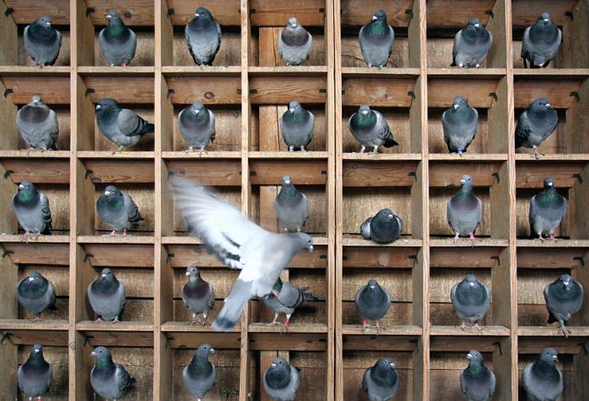
Short kmers

Slide 7
Long kmers
When there are many more
possible observations (4^{k}) than
actual observations, the table is
sparse.
For a 100Gb dataset, this is
10¹¹ pigeons roosting in
10¹² windowsills.
Most windowsills are empty.
AAAAAAAAAAAAAAAAAAAA 0
AAAAAAAAAAAAAAAAAAAC 0
AAAAAAAAAAAAAAAAAAAG 0
...
AAAAAAAAACCTCTTTTTTT 0
AAAAAAAAACCTGAAAAAAA 1
AAAAAAAAACCTGAAAAAAC 0
...
AAAAAAAAAGAAAGGTAACG 0
AAAAAAAAAGAAAGGTAACT 1
AAAAAAAAAGAAAGGTAAGA 0
...
AAAAAAAAAGCCAGCACCCC 0
AAAAAAAAAGCCAGCACCCG 1
AAAAAAAAAGCCAGCACCCT 0
00000000000000000000000000000000000
00000000000000000001000000000000000
00000010000000000000000000000000000
00000000000000000000000000000000000
00000000000000000000000000000000000
00000000000000000000000000000000000
k=20
4²⁰ = 10¹²

Slide 8
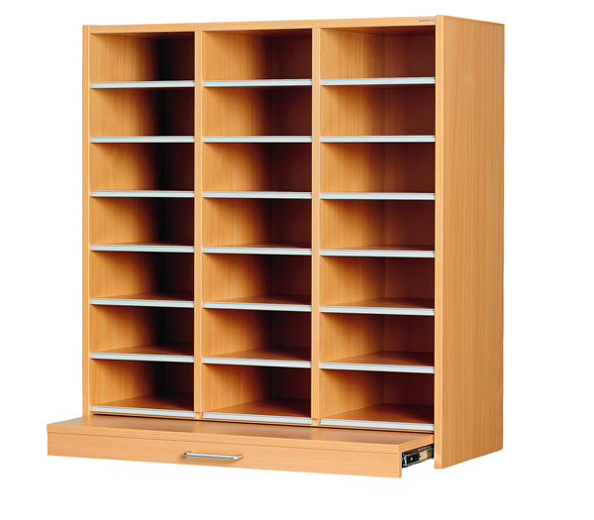
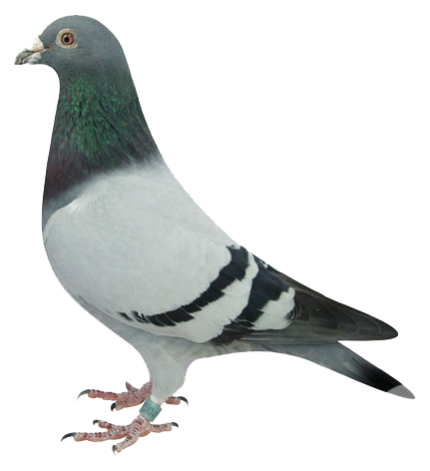
10¹¹
pigeons
10¹²
holes

Slide 9
Short kmers Long kmers
Storing 4^{k >} 10¹² doesn’t work very well, so digital representations are either sparse or probabilistic.
Digests are bulky
Because of sparseness, individual kmers can be interesting. (kmers map.)
Tables of all 4^{k} symbols can be computed by novice programmers.
Digests are compact
Individual short kmers are
not interesting; only aggregate patterns matter.
1 ≤ k < 16
k > 20

Slide 10
Genome kmers vs. data kmers
When sequencing a genome, some of your reads will perfectly represent the genome, and some will contain errors.
But if you sequence a genome to 100x, you will see the same genome sequence over and over again, but
most errors you will only see once.

Slide 11
kmer table -> kmer spectrum.
kmer
number of
occurrences
number of
occurrences
number of
kmers
ATCGCGAAAAGTCCC 2
AAAAAAAAAAAAAAA 459
AAAAAAAAAAAAAAC 71
AAAATAAAAAAAATA 1
AAAAAAAAAAAAAAG 36
ACATGAAAAACAACT 1
AAAAAAAAAAAAAAT 23
AAAAAAAAAAAAACA 95
GTAGGAAAAGCCCAC 1
AAAAAAAAAAAAACC 7
AAAAAAAAAAAAACG 8
AAAAAAAAAAAAACT 9
AAAAAAAAAAAAAGA 36
AACAAGAAAAACAAA 1
AAAAAAAAAAAAAGC 10
AAATAAAAAAAATAG 1
AACAGAAAAAACACG 1
AAAAAAAAAAAAAGG 2
AAAAAAAAAAAAAGT 6
1 79317651
2 3726721
3 952261
4 365963
5 173303
6 92876
...
100 1276
101 1166
…
3268 1
3370 1

Slide 12
kmer table -> kmer spectrum.
kmer
number of
occurrences
number of
occurrences
number of
kmers
ATCGCGAAAAGTCCC 2
AAAAAAAAAAAAAAA 459
AAAAAAAAAAAAAAC 71
AAAATAAAAAAAATA 1
AAAAAAAAAAAAAAG 36
ACATGAAAAACAACT 1
AAAAAAAAAAAAAAT 23
AAAAAAAAAAAAACA 95
GTAGGAAAAGCCCAC 1
AAAAAAAAAAAAAGT 6
AAAAAAAAAAAAACG 8
AAAAAAAAAAAAACT 9
AAAAAAAAAAAAAGA 36
AACAAGAAAAACAAA 1
AAAAAAAAAAAAAGC 10
AAATAAAAAAAATAG 1
AACAGAAAAAACACG 1
AAAAAAAAAAAAAGG 2
1 79317651
2 3726721
3 952261
4 365963
5 173303
6 92876
...
100 1276
101 1166
…
3268 1
3370 1
Yes, it’s the histogram of the histogram.
And it tells us something about pigeon family size – do the same kmers keep showing up over and over or not?

Slide 13
5 million holes
>50 pigoens
100 million holes
1 pigeon each

Slide 14
The kmer spectrum.
microbial genome
number of kmers
21mer abundance

Slide 15
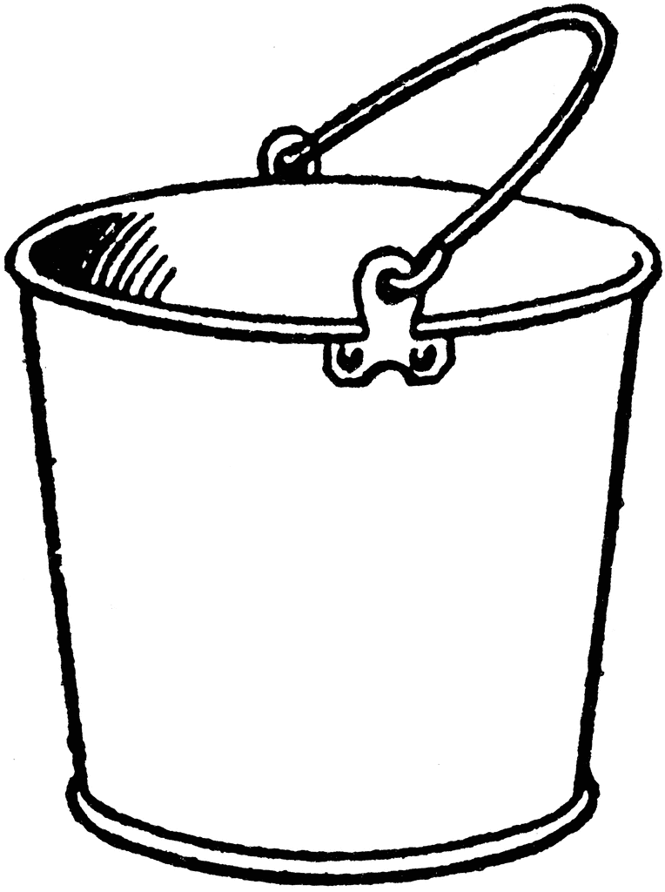
The kmer spectrum.
microbial genome
low-abundance errors
peak contains most of genome
number of kmers
high-abundance peak contains
multicopy genes
really high abundance stuff
often artifacts
21mer abundance
rare
abundant

Slide 16
The kmer spectrum.
microbial genome
Life’s persistent questions:
How much of my data is in errors / genome / repeats / adapters
How large is the genome / repeats / heterozygosity
Did something go wrong?
low-abundance errors
peak contains most of genome
number of kmers
high-abundance peak contains
multicopy genes
really high abundance stuff
often artifacts
21mer abundance
rare
abundant

Slide 17
Abundance /fraction
abundance/fraction
abundant
kmer abundance
rare
fraction of observed kmers

Slide 18
Cumulative ranked kmer spectrum
abundant
21mer abundance
rare
kmer rank (cumulative sum of number of kmers)

Slide 19
Ranked kmers consumed
rare
cumulative fraction of observed kmers
abundant
kmer rank (bp)

Slide 20
Ranked kmers consumed
Unique
fraction
rare
This graph
does not
change shape
with sampling
!!!!!!!
Median kmer
rank
cumulative fraction of observed kmers
abundant
kmer rank (bp)

Slide 21
adapter 0.8% 35
repeats 3% 300x 8000
genome 61% 40x 3.5M
rare 35% 1x 79M

Slide 22
Yes, all these graphs are necessary
Genome size ~ number of kmers (M)
depth ~ abundance (C)
DATA FRACTION (F)

Slide 23
adapter 0.8% 35
repeats 3% 300x 8000
genome 61% 40x 3.5M
rare 35% 1x 79M

Slide 24
adapter 0.8% 35
repeats 3% 300x 8000
genome 61% 40x 3.5M
rare 35% 1x 79M

Slide 25
adapter 0.8% 35
repeats 3% 300x 8000
genome 61% 40x 3.5M
rare 35% 1x 79M

Slide 26
Check: Human reference genome
1 2141383266
2 65007581
3 16171452
4 7542756
5 4250262
6 2791059
7 1931443
8 1390566
9 1018739
10 794306
11 614425
12 507162
13 418706
14 353710
15 311034
16 266206
17 231321
18 202592
19 182020
20 164101

Slide 27
kmer statistical summaries
H0 kmer richness (VERY BAD)
H1 Shannon entropy (BAD)
H2 Reyni entropy / Simpson index (GOOD)
observation-weighted coverage (BAD)
observation-weighted size (BAD)
observation-median coverage (GOOD)
observation-median rank (GOOD)
fraction in top 100 kmers (USEFUL)
fraction unique (OK but requires size correction)

Slide 28
kmer statistical summaries
H0 kmer richness (VERY BAD)
H1 Shannon entropy (BAD)
H2 Reyni entropy / Simpson index (GOOD)
observation-weighted coverage (BAD)
observation-weighted size (BAD)
observation-median coverage (GOOD)
observation-median size (GOOD)
fraction in top 100 kmers (USEFUL)
fraction unique (OK but requires size correction)
Most of these give answers which vary so strongly with sampling depth as to be unusable.
Observation-weighted fraction-of-data metrics behave fairly well. Fractions of the data with particular properties are stable with respect to sampling.

Slide 29
kmer statistical summaries
H0 kmer richness (VERY BAD)
H1 Shannon entropy (BAD)
H2 Reyni entropy / Simpson index (GOOD)
observation-weighted coverage (BAD)
observation-weighted size (BAD)
observation-median coverage (GOOD) C50
observation-median rank (GOOD) M50
fraction in top 100 kmers (USEFUL) F100
fraction unique (OK but requires size correction)

Slide 30
Generalities from the kmer counting mines
Many datasets have as much as 5-45% of the sequence yield in adapters.
FEW DATASETS have well-separated abundance peaks (of the sort metavelvet was engineered to find)
Diverse datasets have a featureless, geometric relationship between kmer rank and kmer abundance.
Shannon entropy is oversensitive to errors. *

Slide 31
Three approaches to error correction:
Filtering (Q-values, tile quality)
Pair-joining
Error correction

Slide 32
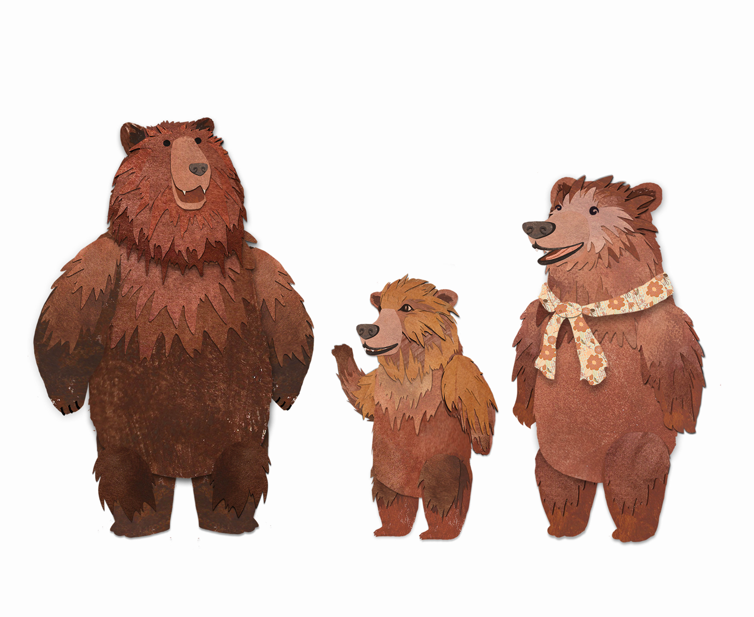
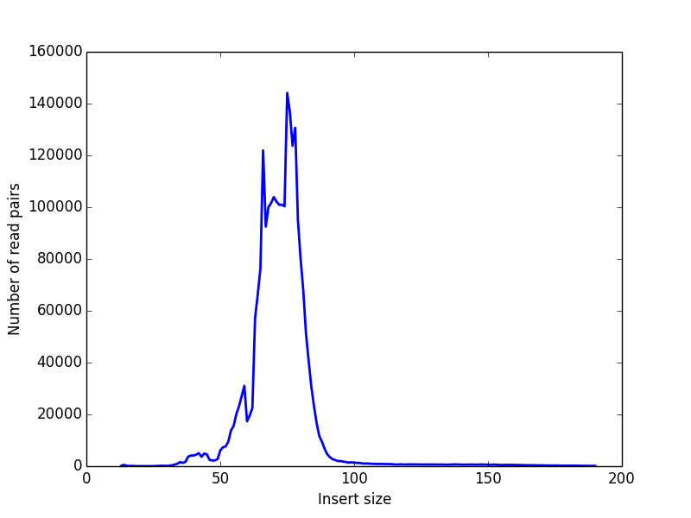
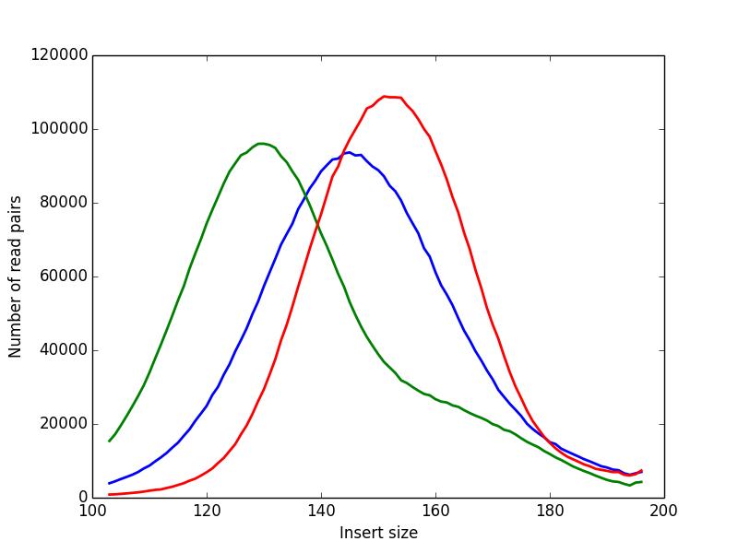
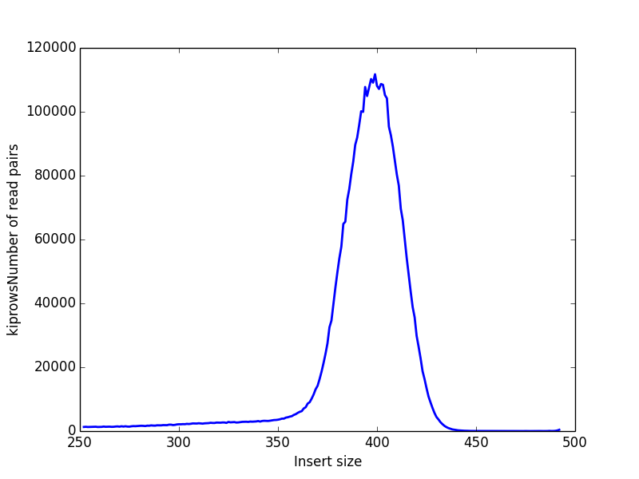
Choosing insert size
0 < insert size < L
eats into adapters
Sequencing adapter
contamination
overlapping reads
L < insert size < 2L
Error-corrected
overlapping reads
unsequenced insert
2 L < insert size
Unsequenced insert
No error correction
60% of sequencing
yield wasted on
adapters; half of the
remainder is redundant.
25% of sequencing
yield consumed in error-correcting overlaps. 75% of basepairs in reads 1.5-1.8L
None of the sequencing is lost, but past 200bp the uncorrected quality is very poor.

Slide 33
Overlapping reads
overlapping reads
L < insert size < 2L
Error-corrected
overlapping reads
Careful size selection results in 90+ % of reads with overlapping ends.
Read joining is easy, cheap.
Produces pile of joined reads and two piles of unjoined reads (and a whole pile of headache keeping read pairs together)
Error correction when reads differ.
Overlap operation benignly reduces total coverage
Size selection may disturb mixture proprtions (“bias”)
What to do with the qualitatively different unoverlapped pairs?
Keep them: possible size – length effect
Discard them: possible size—depth effect

Slide 34
kmer statistical summaries
observation-median coverage (C50)
observation-median rank (M50)
fraction in top 100 kmers (F100)
fraction unique

Slide 35
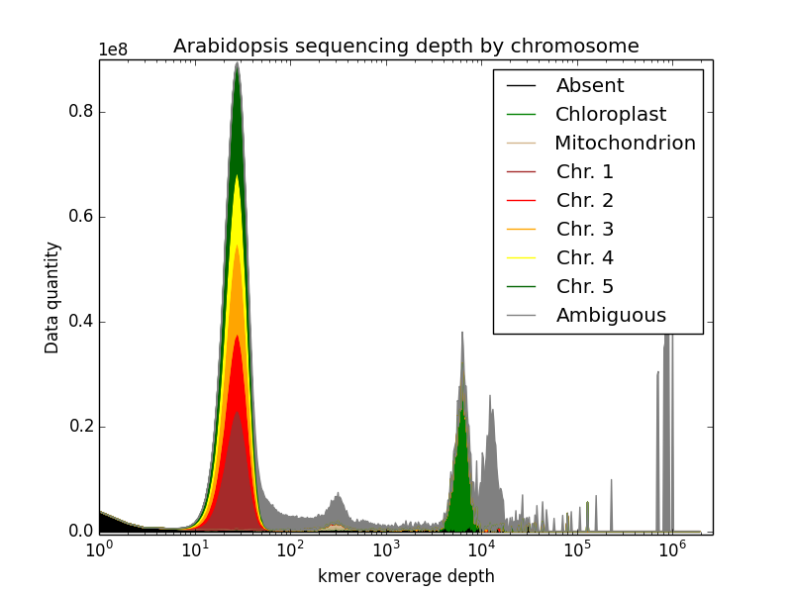
Straightforward abundance distribution: plant
Notes:
This is a kmer spectrum of an arabidopsis mutant sequencing dataset (SRR1810275) that has been colored according to chromosome.
The errors are in black The five chromosomes are various colors The plastid is in green The mitochondrion is in brown.

Slide 36
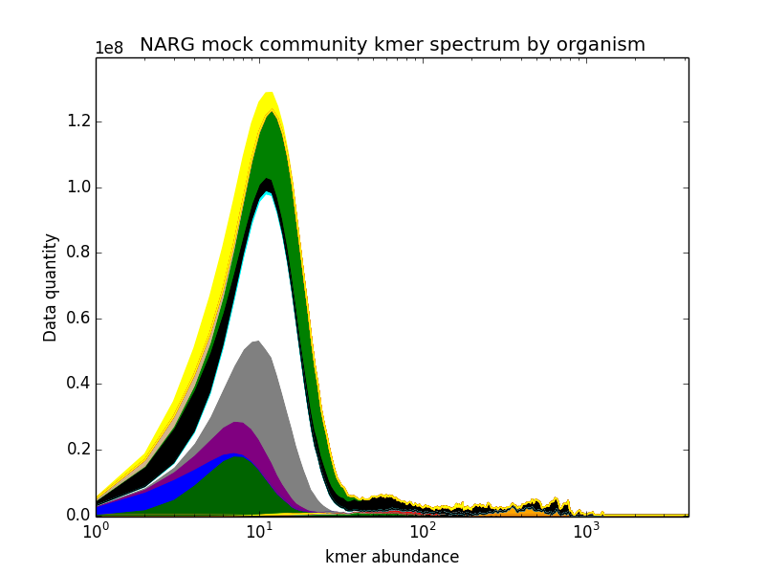
Complex abundance distribution: mock community
Notes:
This is the same color-decomposition trick applied to one of the NARG mock community samples.
Here different colors are different organisms; some organisms come out on top; others don’t.
This color banding is an exploratory technique for known genome sequencing.

Slide 37
The double-counting quirk
ATCGCGAAAAGTCCC 2
AAAAAAAAAAAAAAA 459
AAAAAAAAAAAAAAC 71
AAAATAAAAAAAATA 1
AAAAAAAAAAAAAAG 36
ACATGAAAAACAACT 1
AAAAAAAAAAAAAAT 23
AAAAAAAAAAAAACA 95
GTAGGAAAAGCCCAC 1
AAAAAAAAAAAAACC 7
AAAAAAAAAAAAACG 8
AAAAAAAAAAAAACT 9
AAAAAAAAAAAAAGA 36
AACAAGAAAAACAAA 1
AAAAAAAAAAAAAGC 10
AAATAAAAAAAATAG 1
AACAGAAAAAACACG 1
AAAAAAAAAAAAAGG 2
AAAAAAAAAAAAAGT 6
There is a sense in which AAAAAAAAAAAAAAA
and
TTTTTTTTTTTTTTT
are the same.
2 approaches:
double-count everything
only count once.

Slide 38
We don’t care about the left side!
Hypothesis1
Hypothesis2
Hypothesis3
Nuisance1
Nusiance2
Nuisance3
Observation 1
Observation 2
…
Observation 1+10¹¹
False Signals
genome size
sequencing depth
fragmentation method
lab technican’s choice of music

Slide 39
Generic experiment
Hypothesis1
Hypothesis2
Hypothesis3
Nuisance1
Nusiance2
Nuisance3
Observation 1
Observation 2
…
Observation 1+10¹¹

